Slide 1
Flappy Bird
Members:
Lê Thành Long
Diệp Thiên Thiên
Phạm Trần Đức Trọng
Hoàng Phạm Khương Duy

Slide 2
Assignment
Lê Thành Long | Code homepage, animation, footer | 70%
Diệp Thiên Thiên | Program game, UI, algorithm | 90%
Phạm Trần Đức Trọng | Code Navbar, footer, login, logout, register | 80%
Hoàng Phạm Khương Duy | Code assist in homepage, Navbar, animation, UI,… | 70%
Members
Tasks
Completion rate

Slide 3
Contents
01. Introduction
02. Technologies
03. Development Process
04. Demo
05. Experiences

Slide 4
Timeline
Implement
Complete
Start
19h
10h 04/02
18h
9h
18h
05/02
02/02
Plan
Debug

Slide 5
01
INTRODUCTION

Slide 6

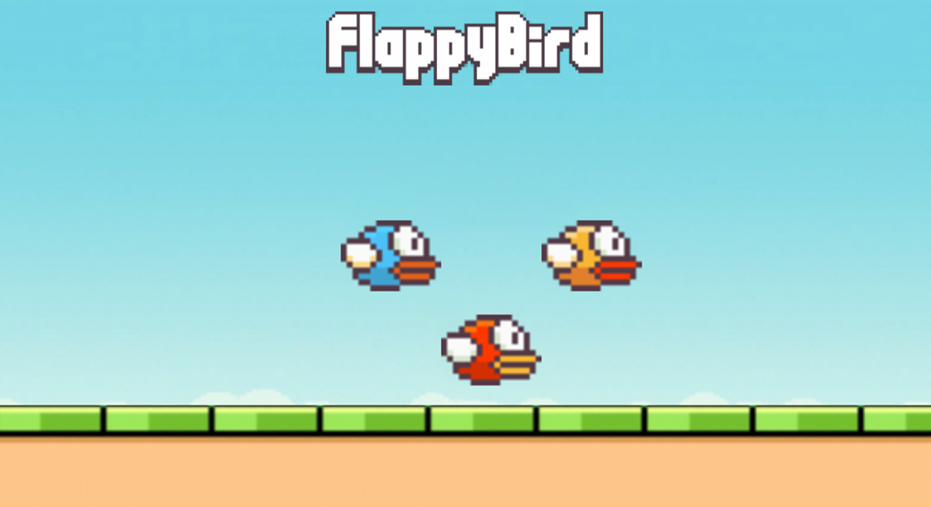
Product’s name
Flappy Bird is a mobile game
The game was released by a Vietnamese company in May 2013 but received a sudden rise in popularity in early 2014

Slide 7
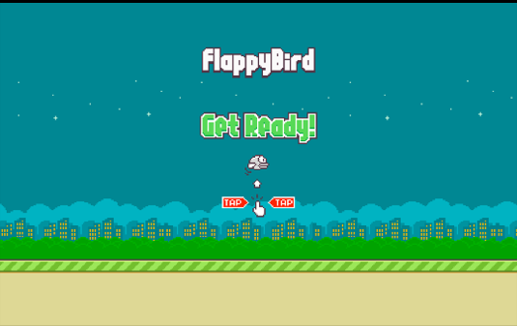
Sign in
Choose character
Play game
High score

Slide 8
02
TECHNOLOGIES

Slide 9





Angular
NodeJS
Firebase

Slide 10
03
DEVELOPMENT PROCESS

Slide 11
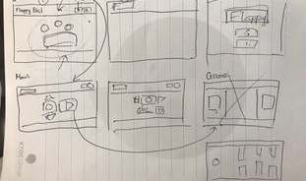
Prototype
Multi-sketches

Slide 12
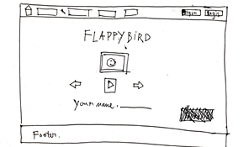
Prototype
Mainpage

Slide 13
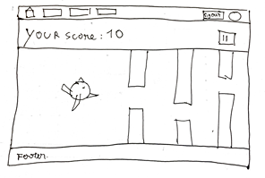
Prototype
Game page

Slide 14
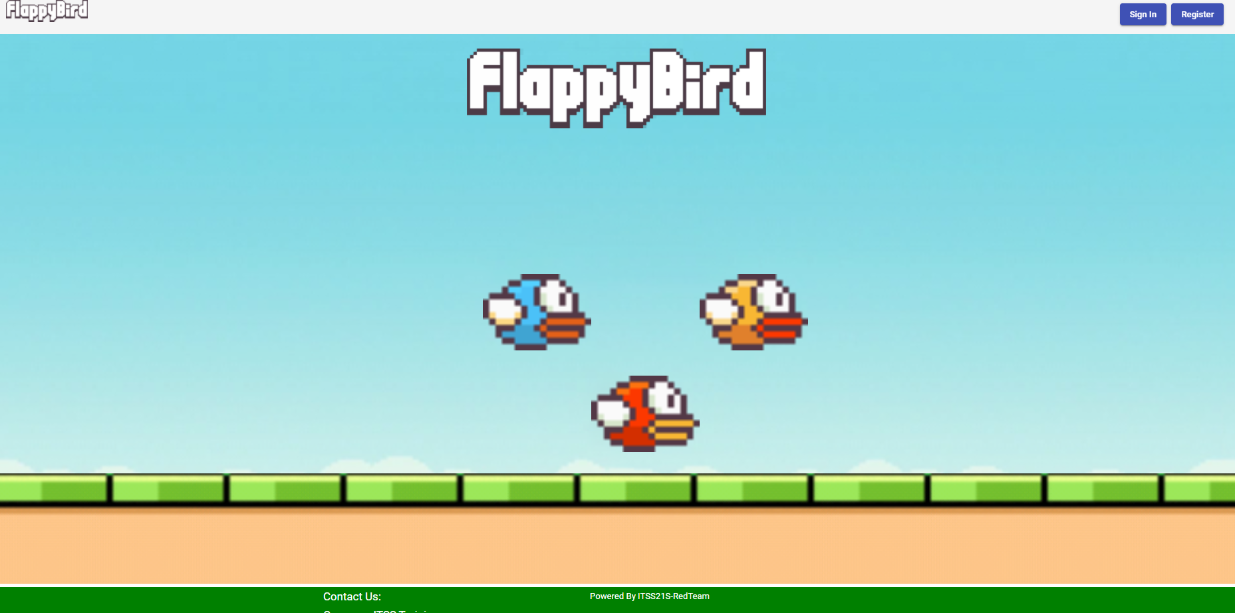
Features
A completed Homepage

Slide 15
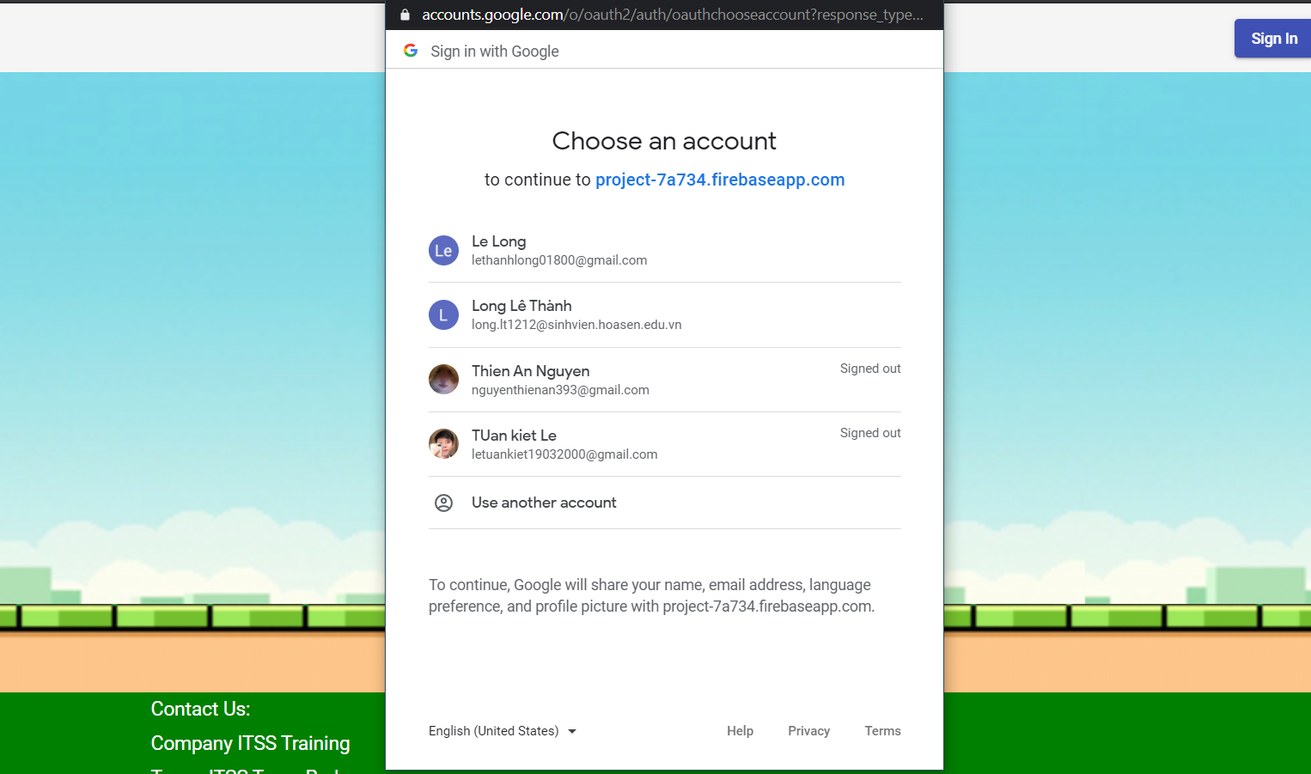
Features
A completed Login page

Slide 16
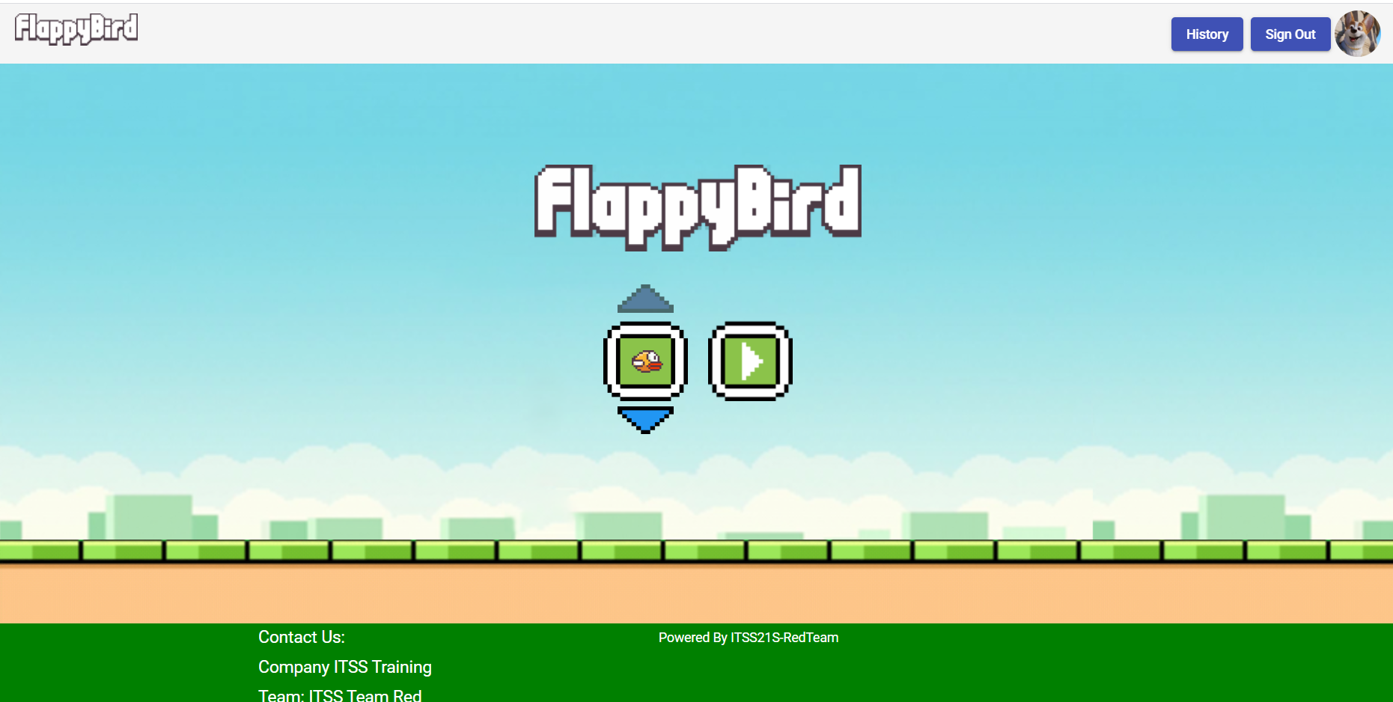
Features
Choose character page

Slide 17
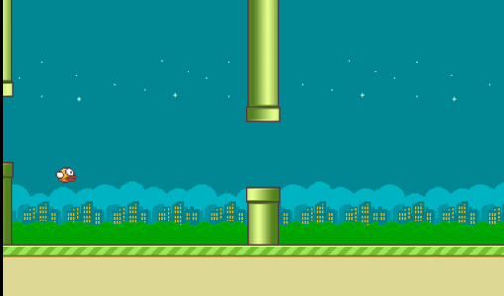
Features
Game page

Slide 18
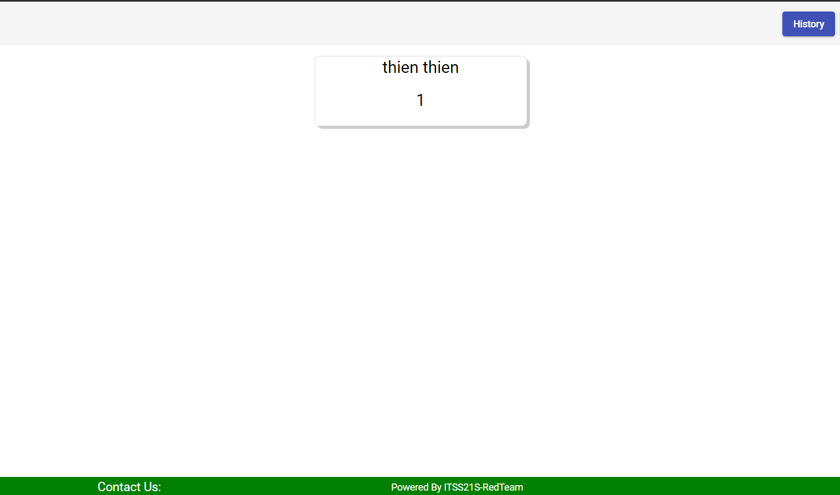
Features
History page

Slide 19
Current Limitations
Choose character page

Slide 20
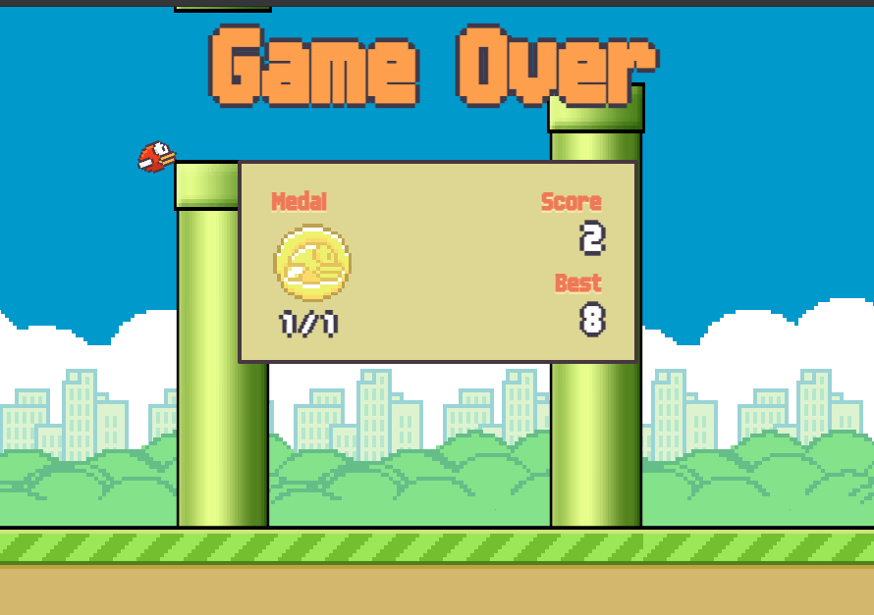
Current Limitations
History page

Slide 21
Demo

Slide 22
05
EXPERIENCES

Slide 23
Experiences
Improve teamwork skills
Complete mini project together
Learn more tools to build the product

Slide 24
Thank you for listening
www.itsstraining.edu.vn

